Slide 1
Scheduling Algorithms
Prof. Shweta Dhawan Chachra
Some material © Silberschatz, Galvin, and Gagne, 2002

Slide 2
Scheduling Algorithms Why??
Maximum CPU utilization obtained with multiprogramming:-
Switching CPU among processes to make the OS more productive
Several processes kept in memory at one time.
When one process has to wait, the OS takes CPU away from that process and gives it to another process.
Scheduling is fundamental OS function.

Slide 3
CPU–I/O Burst Cycle –
Process execution consists of a cycle of CPU execution and I/O wait.
Processes alternate between these 2 states.
Process execution begins with CPU burst,
then followed by I/O burst and so on.
Last CPU burst will end with a system request to terminate execution.
CPU burst distribution is of main concern

Slide 4
Scheduling Algorithm Optimization Criteria
CPU utilization
Throughput
Turnaround time
Waiting time
Response time

Slide 5
Scheduling Criteria
CPU utilization –
keep the CPU as busy as possible,
May vary from 0 to 100%.
In a real system, it should range from 40% (lightly loaded) to 90% (for a heavily used).

Slide 6
Scheduling Criteria
Throughput –
No of processes that complete their execution per time unit

Slide 7
Scheduling Criteria
Turnaround time –
amount of time to execute a particular process
The interval from the time of submission of a process to the time of completion

Slide 8
Scheduling Criteria
Waiting time –
amount of time a process has been waiting in the ready queue/
Sum of periods spent waiting in ready queue

Slide 9
Scheduling Criteria
Response time –
amount of time it takes from when a request was submitted until the first response is produced, not output (for time-sharing environment)

Slide 10
Scheduling Algorithm Optimization Criteria
CPU utilization
Throughput
Turnaround time
Waiting time
Response time
??

Slide 11
Scheduling Algorithm Optimization Criteria
Max CPU utilization
Max throughput
Min turnaround time
Min waiting time
Min response time

Slide 12
CPU Scheduler
Short-term scheduler selects from among the processes in ready queue, and allocates the CPU to one of them
Queue may be ordered in various ways

Slide 13
CPU Scheduler
CPU scheduling decisions may take place when a process:
Switches from running to waiting state
Eg- I/O request, Invocation of wait for the termination of one of the child processes
Switches from running to ready state
Eg- When an interrupt occurs or timer expires
Switches from waiting to ready
Eg-Completion of I/O
Terminates

Slide 14
CPU Scheduler
Scheduling under 1 and 4 is nonpreemptive
All other scheduling is preemptive
Consider access to shared data
Consider preemption while in kernel mode
Consider interrupts occurring during crucial OS activities

Slide 15
Non-Preemptive Scheduling
Under non-preemptive scheduling,
once the CPU has been allocated to a process,
the process keeps the CPU
it releases the CPU either by terminating or by switching to the waiting state.
This scheduling method was used by Microsoft Windows 3.x;

Slide 16
Preemptive Scheduling
Windows 95 introduced preemptive scheduling,
All subsequent versions of Windows operating systems have used preemptive scheduling.

Slide 17
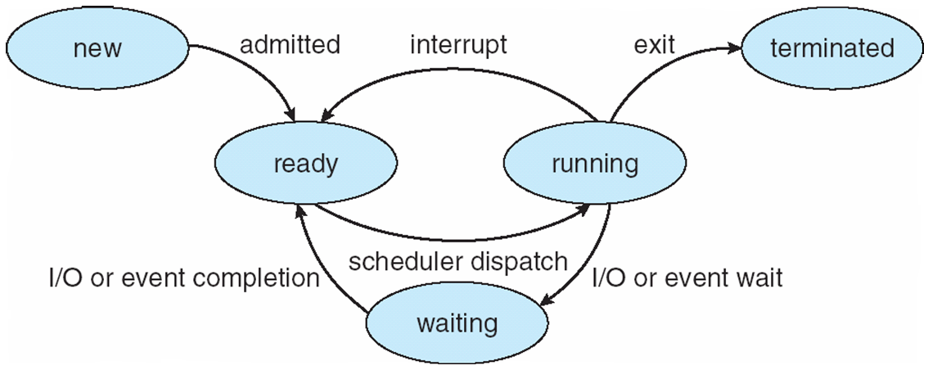
Dispatcher
Dispatcher module gives control of the CPU to the process selected by the short-term scheduler; this involves:
switching context
switching to user mode
jumping to the proper location in the user program to restart that program
Dispatch latency – time it takes for the dispatcher to stop one process and start another running

Slide 18
Non Pre-emptive Algorithms

Slide 19
First- Come, First-Served (FCFS) Scheduling
Simplest CPU scheduling Algorithm
Process that requests CPU first, is allocated CPU first

Slide 20
First- Come, First-Served (FCFS) Scheduling
Implemented using FIFO Queue
Process enters the ready queue, its PCB is linked onto the tail of the queue
When CPU is free, it is allocated to the process at the head of the queue.
The Average Waiting time for FCFS is often quite long.

Slide 21
First- Come, First-Served (FCFS) Scheduling
Process Burst Time
P₁ 24
P₂ 3
P₃ 3

Slide 22
First- Come, First-Served (FCFS) Scheduling
Process Burst Time
P₁ 24
P₂ 3
P₃ 3
Suppose that the processes arrive in the order: P₁ , P₂ , P₃ The Gantt Chart for the schedule is:

Slide 23
First- Come, First-Served (FCFS) Scheduling
Process Burst Time
P₁ 24
P₂ 3
P₃ 3
Suppose that the processes arrive in the order: P₁ , P₂ , P₃ The Gantt Chart for the schedule is:
Waiting time for P₁ = 0; P₂ = 24; P₃ = 27
Average waiting time: (0 + 24 + 27)/3 = 51/3=17

Slide 24
FCFS Scheduling (Cont.)
FCFS is Non-preemptive
Once the CPU is allocated to a process, that process keeps the CPU until it releases the CPU either by terminating or by requesting I/o.
Not good for Time sharing system

Slide 25
FCFS Scheduling (Cont.)
Process Burst Time
P₁ 24
P₂ 3
P₃ 3
Suppose that the processes arrive in the order:
P₂ , P₃ , P₁

Slide 26
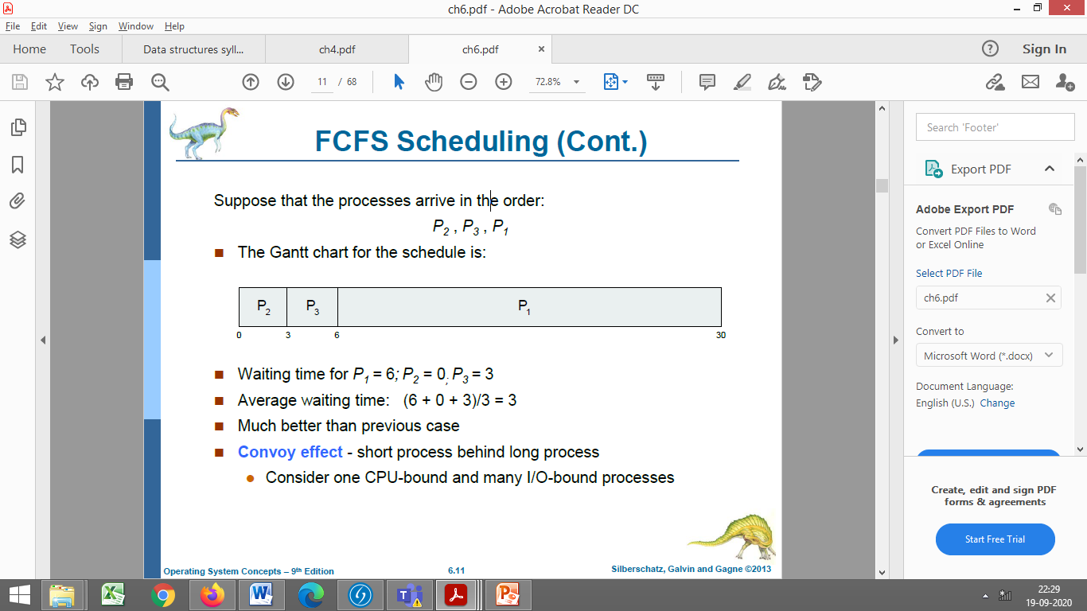
FCFS Scheduling (Cont.)
Process Burst Time
P₁ 24
P₂ 3
P₃ 3
Suppose that the processes arrive in the order:
P₂ , P₃ , P₁
The Gantt chart for the schedule is:

Slide 27
FCFS Scheduling (Cont.)
Process Burst Time
P₁ 24
P₂ 3
P₃ 3
Suppose that the processes arrive in the order:
P₂ , P₃ , P₁
The Gantt chart for the schedule is:
Waiting time for P₁ = 6; P₂ = 0; P₃ = 3
Average waiting time: (6 + 0 + 3)/3 = 3
Much better than previous case

Slide 28

Convoy effect
Convoy effect - short process behind long process
Phenomenon associated with the First Come First Serve (FCFS) algorithm,
In which the whole Operating System slows down due to few large processes.

Slide 29
Convoy effect
The Convoy Effect is a phenomenon where a large or resource-intensive process ties up system resources and causes a backlog of other processes waiting to use those same resources.

Slide 30
Formulae-
Turn Around Time = Completion Time - Arrival Time
Waiting Time = Turn Around Time - Burst Time –Arrival Time or Sum of times spent waiting in Ready queue-Arrival Time
Average waiting time = Total_waiting_time / no_of_processes
Average turnaround time = Total_turn_around_time / no_of_processes

Slide 31
Gantt Chart
Generalized Activity Normalization Time Table (GANTT)
Horizontal bar chart developed by Henry L. Gantt (American engineer and social scientist) in 1917 as production control tool.
Series of horizontal lines are present that show the amount of work done or production completed in given period of time in relation to amount planned for those projects.

Slide 32
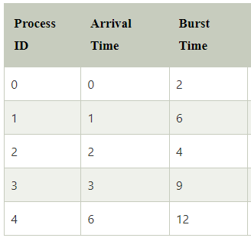
Exercise
Consider 5 processes with process ID P0, P1, P2, P3 and P4. The processes and their respective Arrival and Burst time are given in the following table. Apply FCFS Scheduling algorithm and calculate the following:
Turnaround time
Waiting time for all processes
Average Waiting Time

Slide 33
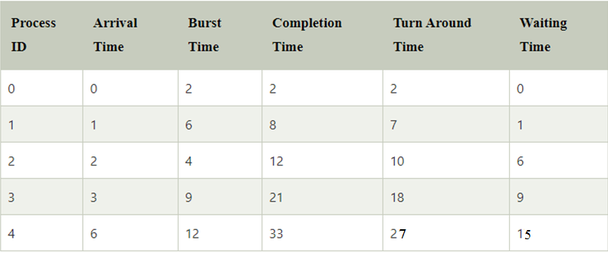

Exercise
Gantt Chart-
Waiting Time=Sum of time spent in Ready Queue-Arrival Time
Turnaround Time=Completion Time-Arrival Time

Slide 34
Exercise
Gantt Chart-
WT(P0)=0-0=0
WT(P1)=2-1=1
WT(P2)=8-2=6
WT(P3)=12-3=9
WT(P4)=21-6=15

Slide 35
Exercise
Gantt Chart-
Avg Waiting Time=31/5
Avg Turnaround Time=66/5

Slide 36
Shortest-Job-First (SJF) Scheduling
An algorithm in which the process having the smallest execution time is chosen for the next execution.
Associate with each process the length of its next CPU burst
Use these lengths to schedule the process with the shortest time

Slide 37
Shortest-Job-First (SJF) Scheduling
SJF is optimal –
gives minimum average waiting time for a given set of processes

Slide 38
Shortest-Job-First (SJF) Scheduling
Two schemes:
Non-preemptive
preemptive – Also known as the Shortest-Remaining-Time-First (SRTF).

Slide 39
Shortest-Job-First (SJF) Scheduling
Non-preemptive SJF is optimal
if all the processes are ready simultaneously– gives minimum average waiting time for a given set of processes.
SRTF is optimal
if the processes may arrive at different times

Slide 40
Example of Non-preemptive SJF
ProcessArriva l TimeBurst Time
P₁ 0.0 6
P₂ 2.0 8
P₃ 4.0 7
P₄ 5.0 3
SJF scheduling chart
Average waiting time = (3 + 16 + 9 + 0) / 4 = 28/4=7

Slide 41
Example for Non-Preemptive SJF with different arrival times
Process Arrival Time Burst Time
P₁ 0.0 7
P₂ 2.0 4
P₃ 4.0 1
P₄ 5.0 4
SJF (non-preemptive)
At time 0, P₁ is the only process, so it gets the CPU and runs to completion
P₁
0
3
7

Slide 42
Example for Non-Preemptive SJF
Process Arrival Time Burst Time
P₁ 0.0 7
P₂ 2.0 4
P₃ 4.0 1
P₄ 5.0 4
Once P₁ has completed the queue now holds P₂, P₃ and P₄
P₃ gets the CPU first since it is the shortest. P₂ then P₄ get the CPU in turn (based on arrival time)
P₁
P₃
P₂
P₄
0
3
7
8
12
16

Slide 43
Round Robin (RR)
What ?
Designed for time sharing systems
Similar to FCFS but preemption is added
Time Quantum/Time Slice-small unit of time is defined, usually 10-100 milliseconds

Slide 44
Round Robin (RR)
What ?
Ready queue is treated as Circular Queue
The CPU scheduler goes around the ready queue, allocating CPU to each process for time interval of upto 1 time Quantum

Slide 45
Round Robin (RR)
How?
Ready Queue uses FIFO order
New processes added to the tail of the ready queue.
The CPU scheduler picks the first process from the ready queue, sets a timer to interrupt after 1 time quantum and dispatches the process.

Slide 46
Round Robin (RR)
How?(contd.)
Two scenarios:
The process may have CPU burst < 1 TQ ,
the process will itself release the CPU voluntarily
CPU burst>1 TQ,
the timer will go off,
causing an interrupt to the OS,
Context switch will be done, process will be put at the tail of the ready queue.

Slide 47
Example of RR with Time Quantum = 4
Process Burst Time
P₁ 24
P₂ 3
P₃ 3

Slide 48

Example of RR with Time Quantum = 4
Process Burst Time
P₁ 24
P₂ 3
P₃ 3
The Gantt chart is:

Slide 49
Example of RR with Time Quantum = 4
Process Burst Time
P₁ 24
P₂ 3
P₃ 3
Waiting Time –
P1=( 0 + (10-4) )=6
P2=4
P3=7
AWT=6+4+7/3=17/3
The Gantt chart is:

Slide 50
Example of RR with Time Quantum = 4
Process Burst Time
P₁ 24
P₂ 3
P₃ 3
The Gantt chart is:
Typically, higher average turnaround than SJF, but better response

Slide 51
Round Robin (RR)
RR is preemptive
If there are n processes in the ready queue and the time quantum is q,
then each process gets 1/n of the CPU time in chunks of at most q time units at once.
No process waits more than (n-1)q time units.

Slide 52
Round Robin (RR)
Performance
Tq large ⇒ RR is same as FIFO
Tq small ⇒ RR is called processor sharing, appears to user as if each of n processes has its own processor running at 1/n the speed of real processor
q must be large with respect to context switch, otherwise overhead is too high

Slide 53
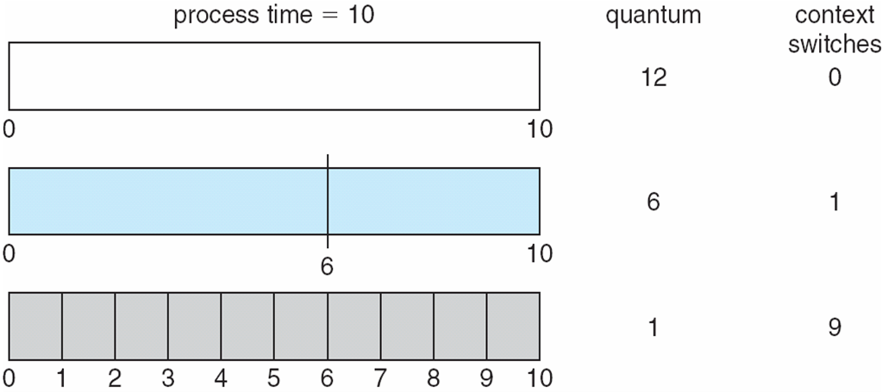
Time Quantum and Context Switch Time

Slide 54
Time Quantum and Context Switch Time
The TQ should be large with respect to the context switch time.
Tq usually 10ms to 100ms, context switch < 10 usec
Else much time will be wasted in Context switching.

Slide 55
Turnaround Time Varies With The Time Quantum
Typically, higher average turnaround than SJF, but better response
The Average turnaround time of a set of processes does not necessarily improve as the time quantum increases.
The ATT can be improved if most processes finish their next CPU burst in single TQ
Thumb Rule- “80% of CPU bursts should be shorter than Tq”

Slide 56
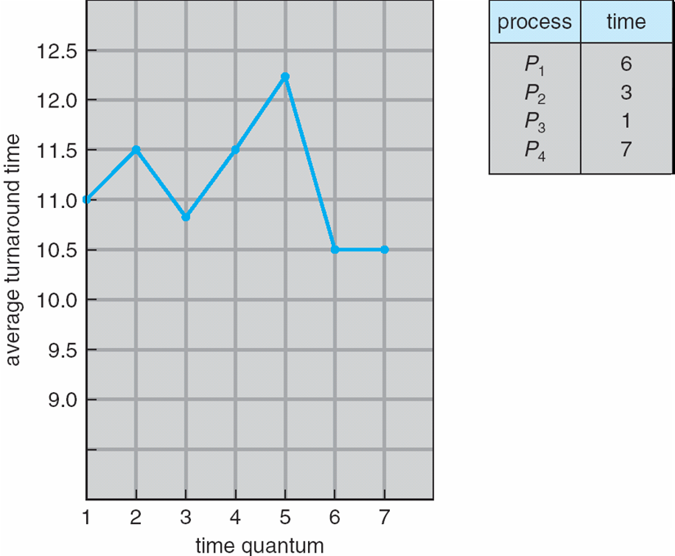
Turnaround Time Varies With The Time Quantum
80% of CPU bursts should be shorter than q
The ATT can be improved if most processes finish their next CPU burst in single TQ
Thumb Rule- “80% of CPU bursts should be shorter than Tq”

Slide 57
Pre-emptive Algorithms

Slide 58
Shortest Remaining Time First (SRTF)
In the Shortest Remaining Time First (SRTF) scheduling algorithm,
The process with the smallest amount of time remaining until completion is selected to execute.

Slide 59
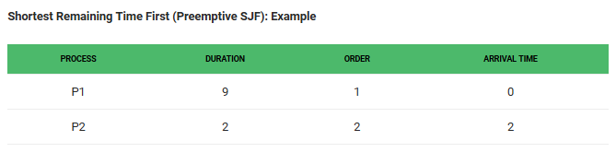

Slide 60

P1 waiting time: 0 + (4-2-0) = 2 P2 waiting time: (2-2)=0 The average waiting time(AWT): (0 + 2) / 2 = 1

Slide 61
Example for Preemptive SJF (SRTF)
Process Arrival Time Burst Time
P₁ 0.0 7
P₂ 2.0 4
P₃ 4.0 1
P₄ 5.0 4

Slide 62
Example for Preemptive SJF (SRTF)
Process Arrival Time Burst Time
P₁ 0.0 7
P₂ 2.0 4
P₃ 4.0 1
P₄ 5.0 4
Time 0 – P₁ gets the CPU Ready = [(P₁,7)}
Time 2 – P₂ arrives – CPU has P₁ with rem. time=5,
Ready = [(P₂,4)] -P₂ gets the CPU, P1 is preempted
Ready = [(P₁,5)]
Time 4 – P₃ arrives – CPU has P₂ with rem. time = 2,
Ready = [(P₁,5),(P₃,1)] – P₃ gets the CPU, P2 is preempted
Ready = [(P₁,5),(P2,2)}
P₁
P₂
P₃
2
4
5

Slide 63
Example for Preemptive SJF (SRTF)
Process Arrival Time Burst Time
P₁ 0.0 7
P₂ 2.0 4
P₃ 4.0 1
P₄ 5.0 4
Ready = [(P₁,5),(P2,2)]
Time 5 – P₃ completes and P₄ arrives –
Ready = [(P₁,5),(P₂,2),(P₄,4)] – P₂ gets the CPU
Time 7 – P₂ completes –
Ready = [(P₁,5),(P₄,4)] – P₄ gets the CPU
Time 11 – P₄ completes, P₁ gets the CPU
P₁
P₂
P₃
P₂
P₄
P₁
2
4
5
7
11
16

Slide 64
Example for Preemptive SJF (SRTF)
Process Arrival Time Burst Time
P₁ 0.0 7
P₂ 2.0 4
P₃ 4.0 1
P₄ 5.0 4
SJF (preemptive)
Waiting Time for Processes:
P1=(0+(11-2))=9,
P2=((2-2)+(5-4))=1,
P3=(4-4)=0,
P4=(7-5)=2
Average waiting time = (9 + 1 + 0 +2)/4 = 3
P₁
P₂
P₃
P₂
P₄
P₁
2
4
5
7
11
16

Slide 65
Example of Shortest-remaining-time-first
ProcessA arri Arrival TimeT Burst Time
P₁ 0 8
P₂ 1 4
P₃ 2 9
P₄ 3 5
????
Try solving this…………

Slide 66
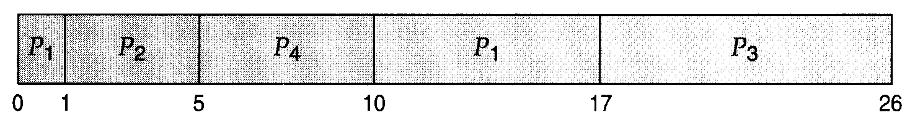
Example of Shortest-remaining-time-first
ProcessA arri Arrival TimeT Burst Time
P₁ 0 8
P₂ 1 4
P₃ 2 9
P₄ 3 5
Time 0 – P₁ gets the CPU Ready = [(P₁,8)]
Time 1 – P₂ arrives – CPU has P₁ with rem. time=7, Ready = [(P₂,4)] – P₂ gets the CPU
Time 2 – P₃ arrives – CPU has P₂ with rem. time = 3, Ready = [(P₁,7)(P₃,9)] – P2 continues with the CPU
Time 3- P4 arrives- CPU has P2 with rem. time=2, Ready =[(P₁,7)(P₃,9)(P4,5)] – P2 continues with the CPU
After P2 finishes, then P4 executes , then P1 , finally P3
Preemptive SJF Gantt Chart
Average waiting time = [(10-1)+(1-1)+(17-2)+(5-3)]/4 = 26/4 = 6.5 msec

Slide 67
Estimating the Length of Next CPU Burst
Problem with SJF: It is very difficult to know exactly the length of the next CPU burst.
Idea: Based on the observations in the recent past, we can try to predict.

Slide 68
Estimating the Length of Next CPU Burst
Exponential averaging:
nth CPU burst = t_{n}
the average of all past bursts τ_{n},
using a weighting factor 0<=α<=1,
the next CPU burst is: τ_{n+1} = α t_{n} + (1- α) τ_{n}.

Slide 69
Estimating the Length of Next CPU Burst
This formula defines an Exponential average of the measured lengths of previous CPU bursts.
t_{n}= nth CPU burst , contains most recent information,
τ_{n} =the average of all past bursts, contains past history,
α controls the relative weight of recent and past history in our prediction.
We expect that the next CPU burst will be similar in length to the previous ones.
τ_{n+1} = α t_{n} + (1- α) τ_{n}.

Slide 70
Examples of Exponential Averaging
α =0
τ_{n+1} = τ_{n}
Recent history does not matter
α =1
τ_{n+1} = t_{n}
Only the most recent CPU burst matters
history is assumed to be old and irrevelant.
τ_{n+1} = α t_{n} + (1- α) τ_{n}

Slide 71
Estimating the Length of Next CPU Burst
More commonly α=1/2, so recent history and past history is equally weighted
The initial τ₀ can be defined as a constant or as an overall system average
τ_{n+1} = α t_{n} + (1- α) τ_{n}.

Slide 72
Examples of Exponential Averaging
To Understand the behavior of the exponential average,
We can expand the formula for τ_{n+1} by substituting for τ_{n} ,If we expand the formula, we get:
τ_{n+1} = α t_{n}+(1 - α)α t_{n} ₋₁ + …
+(1 - α )^{j} α t_{n} _{-j} + …
+(1 - α )^{n +1} τ₀
Since both α and (1 - α) are less than or equal to 1, each successive term has less weight than its predecessor

Slide 73
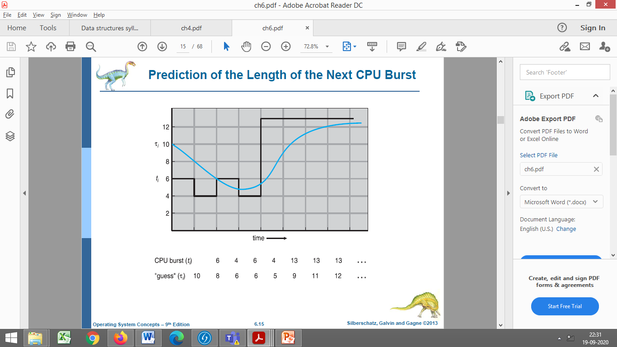
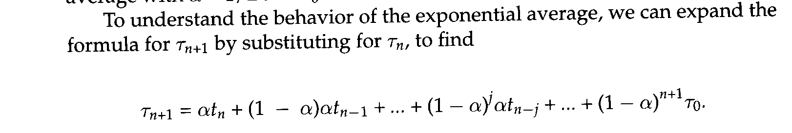
Estimating the Length of Next CPU Burst
Figure shows exponential average with α=1/2 and τ₀=10

Slide 74
Priority Scheduling
A priority number (integer) is associated with each process
The CPU is allocated to the process with the highest priority (smallest integer ≡ highest priority)

Slide 75
Priority Scheduling
SJF is a special case of priority scheduling:
process priority = the inverse of remaining CPU time
The larger the CPU burst, the lower the priority and vice versa
Equal priority processes are scheduled in FCFS order
FCFS can be used to break ties.

Slide 76
Priority Scheduling
We discuss in terms of High, low priority
Priority are fixed range of numbers such as 0 to 7 or 0 to 4,095.
No agreement on whether 0 is highest /lowest.
Some systems use lower numbers to represent low priority other use low numbers for high priority.
Here , we use low numbers for high priority

Slide 77
Priority Scheduling
Priorities can be defined:
Internally
externally

Slide 78
Priority Scheduling
Internally defined-
Use Some measurable quantities
Eg- time limits, memory requirements, the number of open files, ratio of average I/O burst to average CPU burst have been used
Externally defined-
Set by criteria that are external to the OS
Importance of the process
Type and amount of fund being paid for computer use
The Department sponsoring the work
Often political factors

Slide 79
Priority Scheduling
Priority can be :
pre-emptive
non pre-emptive
When a process arrives at the ready queue,
the priority is compared with priority of the current running process.

Slide 80
Priority Scheduling
Scenario:
If the priority of the newly arrived process is higher than the priority of the currently running process.
Characteristics:
A preemptive priority scheduling algorithm will
preempt the CPU
A non-preemptive priority scheduling algorithm will
simply put the new process at the head of the ready queue ,

Slide 81
Priority Scheduling
Problem ≡ Starvation/Indefinite blocking
Solution ≡ Aging

Slide 82
Priority Scheduling
Problem ≡ Starvation/Indefinite blocking
Low priority processes may never execute
Leave some low priority processes waiting indefinitely for the CPU

Slide 83
Priority Scheduling
Solution ≡ Aging – as time progresses increase the priority of the process that wait in the system for a long time.
For eg- If priorities range from 127 (low) to 0 (high), decrement the priority of a waiting process by 1 every 15 minutes.

Slide 84
Example of Non Pre-emptive Priority Scheduling
Process Burst TimeT Priority
P₁ 10 3
P₂ 1 1
P₃ 2 4
P₄ 1 5
P₅ 5 2

Slide 85

Example of Non Pre-emptive Priority Scheduling
Process Burst TimeT Priority
P₁ 10 3
P₂ 1 1
P₃ 2 4
P₄ 1 5
P₅ 5 2
Priority scheduling Gantt Chart
Waiting Time of Processes-
P1=6
P2=0
P3=16
P4=18
P5=1
Average waiting time = =(6+0+16+18+1)/5=41/5=8.2 msec
2
5

Slide 86
Preemptive Priority Scheduling
Process Id | Priority | Arrival Time | Burst Time
1 | 2 | 0 | 1
2 | 6 | 1 | 7
3 | 3 | 2 | 3
4 | 5 | 3 | 6
5 | 4 | 4 | 5
6 | 10 | 5 | 15
7 | 9 | 15 | 8

Slide 87


Preemptive Priority Scheduling
Process Id | Priority | Arrival Time | Burst Time
1 | 2 | 0 | 1
2 | 6 | 1 | 7
3 | 3 | 2 | 3
4 | 5 | 3 | 6
5 | 4 | 4 | 5
6 | 10 | 5 | 15
7 | 9 | 15 | 8
At time=0, P1 arrives with the burst time of 1 units and priority 2.
Since no other process is available hence this will be scheduled till next job arrives or its completion (whichever is lesser).
Ready Queue={(P1,BT=1,PR=2)}
√
At time=1, P2 arrives.
P1 terminates
No other process is available at this time hence the Operating system has to schedule P2 regardless of the priority assigned to it.
Ready Queue={(P2,BT=7,PR=6)}

Slide 88

Preemptive Priority Scheduling
Process Id | Priority | Arrival Time | Burst Time
1 | 2 | 0 | 1
2 | 6 | 1 | 7
3 | 3 | 2 | 3
4 | 5 | 3 | 6
5 | 4 | 4 | 5
6 | 10 | 5 | 15
7 | 9 | 15 | 8
At Time=2
P3 arrives , the priority of P3 is higher to P2.
Ready Queue={(P3,BT=3,PR=3)}
P2 with Remaining Time=6,PR=6
P2 is Pre-empted
P3 is selected
Ready Queue={(P2,Rem BT=6,PR=6)}
√

Slide 89

Preemptive Priority Scheduling
Process Id | Priority | Arrival Time | Burst Time
1 | 2 | 0 | 1
2 | 6 | 1 | 7
3 | 3 | 2 | 3
4 | 5 | 3 | 6
5 | 4 | 4 | 5
6 | 10 | 5 | 15
7 | 9 | 15 | 8
√
√
During the execution of P3, three more processes P4, P5 and P6 becomes available.
Ready Queue={(P2,Rem BT=6,PR=6), (P4, BT=6,PR=5), (P5,BT=5,PR=4), (P6,BT=15,PR=10)}
Since, all these three have the priority lower to P3,
No pre-emption, P3 continues
At t=5, P3 terminates

Slide 90

Preemptive Priority Scheduling
Ready Queue={(P2,Rem BT=6,PR=6), (P4, BT=6,PR=5), (P5,BT=5,PR=4), (P6,BT=15,PR=10)}
P5 will be scheduled with the priority highest among the available processes.
During the execution of P5, all the processes got available in the ready queue. At this point, the algorithm will start behaving as Non Preemptive Priority Scheduling.
Ready Queue={(P2,Rem BT=6,PR=6), (P4, BT=6,PR=5), (P6,BT=15,PR=10)}
At t=10, P5 terminates
P4 selected with highest priority in ready queue and will be executed till the completion.
Ready Queue={(P2,Rem BT=6,PR=6), (P6,BT=15,PR=10)}
At t=15, P7 arrives, with lower priority, P4 continues
At t=16, P4 terminates
Process Id | Priority | Arrival Time | Burst Time
1 | 2 | 0 | 1
2 | 6 | 1 | 7
3 | 3 | 2 | 3
4 | 5 | 3 | 6
5 | 4 | 4 | 5
6 | 10 | 5 | 15
7 | 9 | 15 | 8
√
√
√
√

Slide 91

Preemptive Priority Scheduling
At t=16
Ready Queue={(P2,Rem BT=6,PR=6), (P6,BT=15,PR=10) (P7,BT=8,PR=9)}
P2 is selected, as it has highest priority
P2 terminates
Ready Queue={(P6,BT=15,PR=10),(P7,BT=8,PR=9)}
Process Id | Priority | Arrival Time | Burst Time
1 | 2 | 0 | 1
2 | 6 | 1 | 7
3 | 3 | 2 | 3
4 | 5 | 3 | 6
5 | 4 | 4 | 5
6 | 10 | 5 | 15
7 | 9 | 15 | 8
√
√
√
√
√

Slide 92


Preemptive Priority Scheduling
Process Id | Priority | Arrival Time | Burst Time
1 | 2 | 0 | 1
2 | 6 | 1 | 7
3 | 3 | 2 | 3
4 | 5 | 3 | 6
5 | 4 | 4 | 5
6 | 10 | 5 | 15
7 | 9 | 15 | 8
Ready Queue={(P6,BT=15,PR=10),(P7,BT=8,PR=9}
P7 will be selected
√
√
√
√
√
√
√
The only remaining process is P6 with the least priority, will be executed at the last.

Slide 93
Preemptive Priority Scheduling
Process Id | Priority | Arrival Time | Burst Time | Completion Time | Turn around Time | Waiting Time
1 | 2 | 0 | 1 | 1 | 1 | 0
2 | 6 | 1 | 7 | 22 | 21 | 14
3 | 3 | 2 | 3 | 5 | 3 | 0
4 | 5 | 3 | 6 | 16 | 13 | 7
5 | 4 | 4 | 5 | 10 | 6 | 1
6 | 10 | 5 | 15 | 45 | 40 | 25
7 | 9 | 6 | 8 | 30 | 24 | 16
Turnaround Time = Completion Time - Arrival Time
Waiting Time = Turn Around Time - Burst Time or Sum of times spent in Ready queue
Avg Waiting Time = (0+14+0+7+1+25+16)/7 = 63/7 = 9 units
https://www.javatpoint.com/os-preemptive-priority-scheduling

Slide 94
Multilevel Queue
What?
Processes are classified into different groups.
Common division is
foreground (interactive)
background (batch)

Slide 95
Multilevel Queue
Why?
These Processes
have different response time requirements ,
so have different scheduling needs.
Foreground process have higher priority over background processes

Slide 96
Multilevel Queue
How?
Multi Level Queue Scheduling Algorithm(MQSA) partitions Ready queue into separate queues, eg:
Process permanently assigned to a given queue based on some property as:
Process priority
Process type
Memory size

Slide 97
Multilevel Queue
Each queue has its own scheduling algorithm:
foreground – RR
background – FCFS
Scheduling must be done between the queues:
Fixed priority scheduling;
Time Slicing

Slide 98
Multilevel Queue
Fixed priority scheduling;
Foreground Queue has absolute priority over Background queue
Serve all from foreground then from background
Possibility of starvation.

Slide 99
Multilevel Queue
Time slice between the queue
each queue gets a certain amount of CPU time which it can schedule amongst its processes;
For eg, 80% of CPU time to foreground in RR
20% to background in FCFS

Slide 100
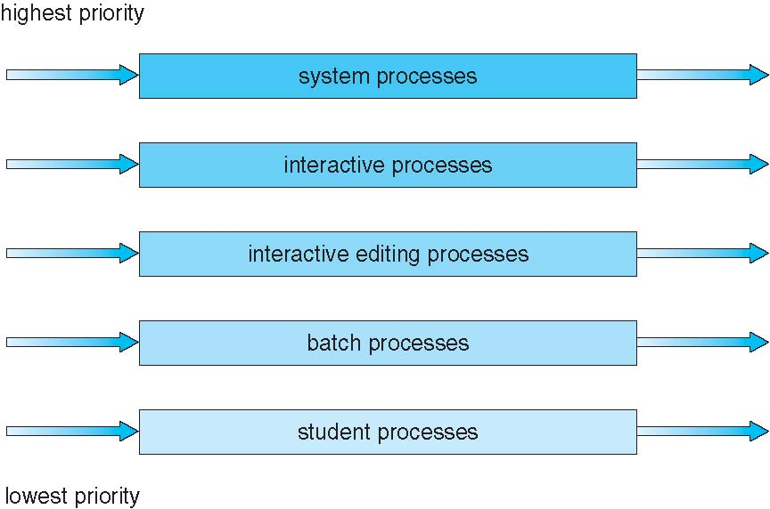
Multilevel Queue Scheduling

Slide 101
Multilevel Queue- Possibility of starvation
MQSA with 5 queues
Each queue has absolute priority over lower priority queues.
No process in batch queue could run
unless the queues from system, interactive, interactive editing queue were all empty.

Slide 102
Multilevel Queue- Possibility of starvation
If an interacting editing process entered the ready queue while a batch process was running,
the batch process would be preempted.

Slide 103
Multilevel Queue
Process do not move between queues.
Since processes do not change their foreground or background nature.
Advantage-
Low scheduling overhead
Disadvantage –
Being Inflexible

Slide 104
Multilevel Feedback Queue
A process can move between the various queues
How?

Slide 105
Multilevel Feedback Queue
How?
The idea is to Separate Processes with different CPU burst characteristic.
Process uses too much CPU time,
will be moved to a lower priority queue.
This scheme leaves I/O bound and interactive processes
in the higher priority queues.

Slide 106
Multilevel Feedback Queue
Starvation=
A process that waits too long in a lower priority queue
Solution=
Aging can be implemented this way to prevent starvation
may be moved to a higher priority queue.

Slide 107
Multilevel Feedback Queue
Multilevel-feedback-queue scheduler defined by the following parameters:
number of queues
scheduling algorithms for each queue
method used to determine when to upgrade a process
method used to determine when to demote a process
method used to determine which queue a process will enter when that process needs service
Most general scheme but most complex

Slide 108
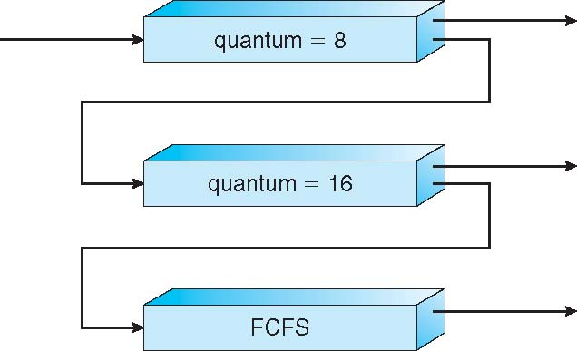
Example of Multilevel Feedback Queue
Three queues:
Q₀ – RR with time quantum 8 milliseconds
Q₁ – RR time quantum 16 milliseconds
Q₂ – FCFS

Slide 109
Example of Multilevel Feedback Queue
Scheduler first executes all processes in Queue 0,
Only when Queue0 is empty,
will it execute processes in Queue1.
Queue2 will be executed
only when Queue 0 and Queue 1 is empty

Slide 110
Example of Multilevel Feedback Queue
A process that arrives for Q1
will preempt a process in Q2
A process that arrives for Q0
will preempt a process in Q1

Slide 111
Example of Multilevel Feedback Queue
Scheduling
A new job enters queue Q₀ which is served RR
When it gains CPU, job receives 8 milliseconds
If it does not finish in 8 milliseconds, job is moved to tail of queue Q₁

Slide 112
Example of Multilevel Feedback Queue
Scheduling
If Q0 is empty, the process at the head of Q1 is given time quantum of 16 milliseconds
At Q₁ job again receives 16 additional milliseconds
If it still does not complete, it is preempted and moved to queue Q₂

Slide 113
Example of Multilevel Feedback Queue
Scheduling
Processes with CPU burst of 8 ms or less are given high priority
Processes with CPU burst >8 but <24 ms are also served quickly with less priority
Long processes automatically sink to Queue 2

Slide 114
Advantages of Multilevel Scheduling:
You can use multilevel queue scheduling to apply different scheduling methods to distinct processes.
It will have low overhead in terms of scheduling.

Slide 115
Disadvantages of Multilevel Scheduling:
There is a risk of starvation for lower priority processes.
It is rigid in nature.

Slide 116
Advantages of Multilevel Feedback Queue Scheduling:
It is more flexible.
It allows different processes to move between different queues.
It prevents starvation by moving a process that waits too long for the lower priority queue to the higher priority queue.

Slide 117
Disadvantages of Multilevel Feedback Queue Scheduling:
It produces more CPU overheads.
It is the most complex algorithm.

Slide 118
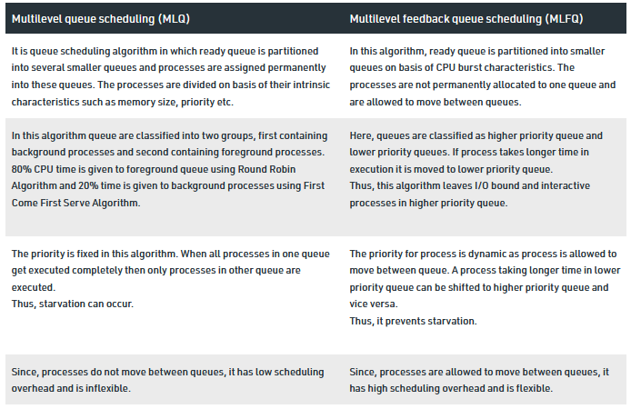
Difference b/w MLQ and MLFQ

Slide 119
Linux Scheduling

Slide 120
Linux Scheduling Prior to kernel Version 2.5
Prior to kernel version 2.5, ran variation of traditional UNIX scheduling algorithm
Two problems with the traditional UNIX scheduler are
it does not provide adequate support for SMP systems
it does not scale well as the number of tasks on the system grows.

Slide 121
Linux Scheduling Through Version 2.5
Version 2.5 moved to constant order O(1) scheduling time
Regardless of the number of tasks on the system.
The new scheduler also provides
increased support for SMP,
including processor affinity and load balancing,
as well as providing fairness and support for interactive tasks.

Slide 122
Linux Scheduling Through Version 2.5
The Linux scheduler is
a preemptive priority-based algorithm

Slide 123
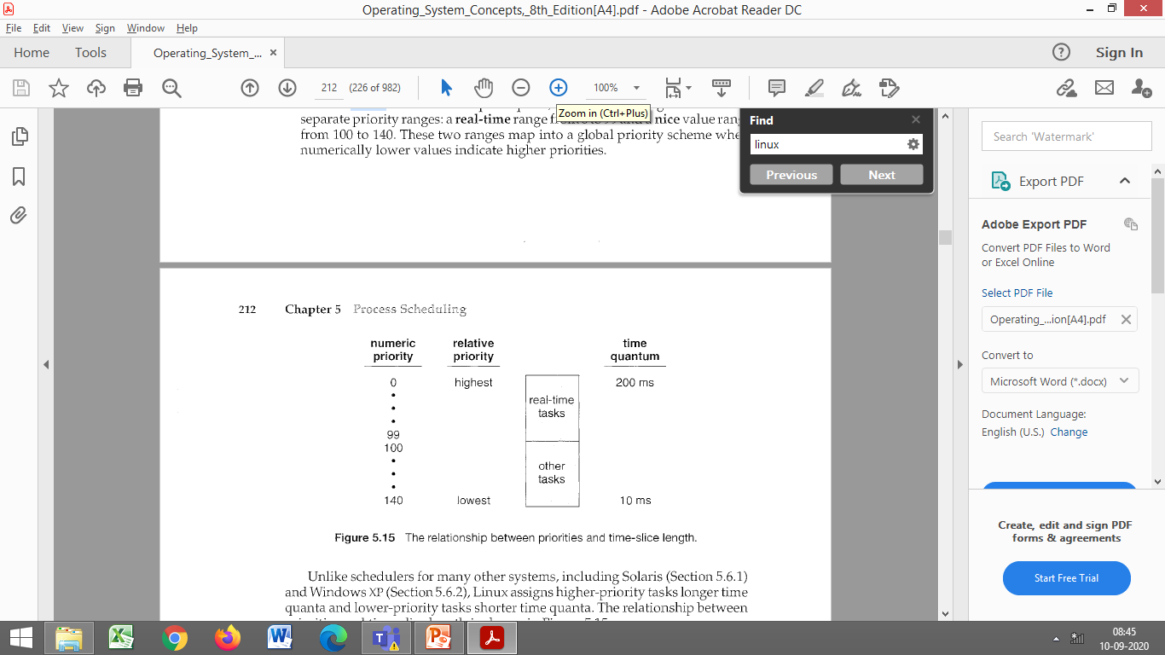
Linux Scheduling Through Version 2.5
The Linux scheduler is
a preemptive priority-based algorithm
with two separate priority ranges:
a real-time range from 0 to 99 and
a nice value ranging from 100 to 140.
real-time
value
nice value

Slide 124
Linux Scheduling Through Version 2.5
These two ranges map into a global priority scheme wherein
numerically lower values indicate higher priorities.
real-time
value
nice value

Slide 125
Linux Scheduling Through Version 2.5
Unlike schedulers for many other systems, including
Solaris
Windows XP
Linux assigns
higher-priority tasks longer time quanta and
lower-priority tasks shorter time quanta.

Slide 126
Linux Scheduling Through Version 2.5
A runnable task is considered eligible for execution on the CPU
as long as it has time remaining in its time slice.
When a task has exhausted its time slice,
it is considered expired and
is not eligible for execution again
until all other tasks have also exhausted their time quanta.

Slide 127
Linux Scheduling Through Version 2.5
The kernel maintains a list of all runnable tasks
in a runqueue data structure.

Slide 128
Linux Scheduling Through Version 2.5
Because of its support for SMP,
Each processor maintains
its own runqueue and
schedules itself independently.

Slide 129
Linux Scheduling Through Version 2.5
Each runqueue contains two priority arrays:
Active
Expired

Slide 130
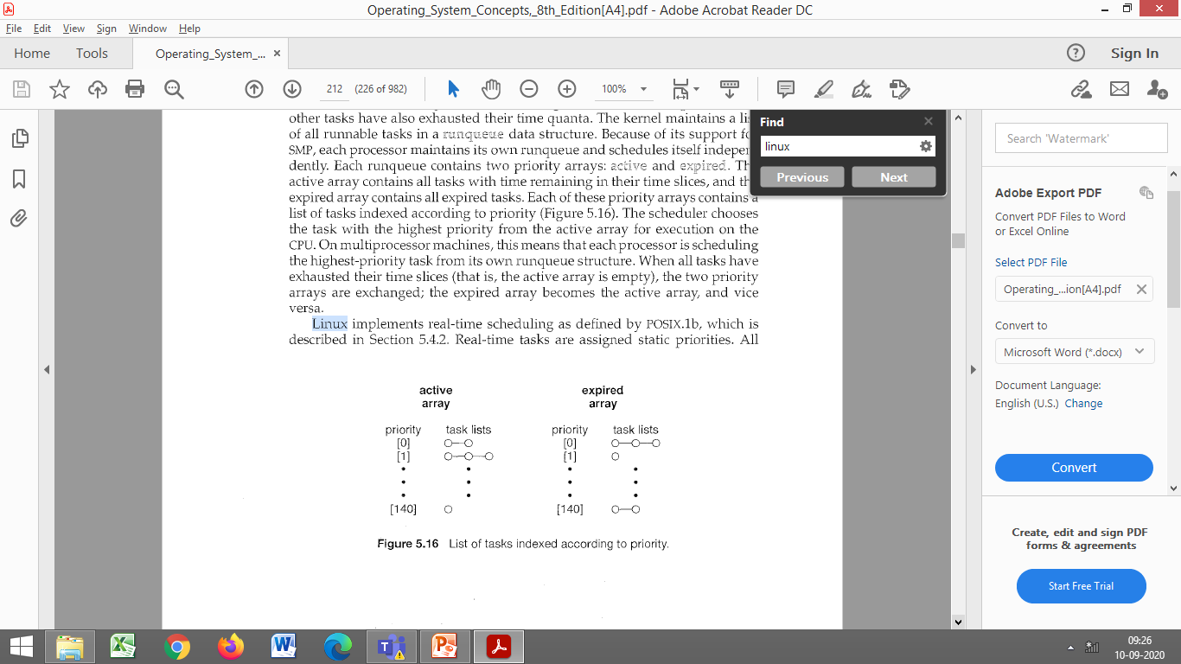
Linux Scheduling Through Version 2.5
The active array
contains all tasks with time remaining in their time slices,
The expired array
contains all expired tasks.

Slide 131
Linux Scheduling Through Version 2.5
Each of these priority arrays contains
a list of tasks indexed according to priority

Slide 132
Linux Scheduling Through Version 2.5
The scheduler chooses the task
with the highest priority from the active array
for execution on the CPU.

Slide 133
Linux Scheduling Through Version 2.5
On multiprocessor machines,
each processor is scheduling the highest-priority task
from its own runqueue structure.
When all tasks have exhausted their time slices (that is, the active array is empty),
the two priority arrays are exchanged;
the expired array becomes the active array, and vice versa.

Slide 134
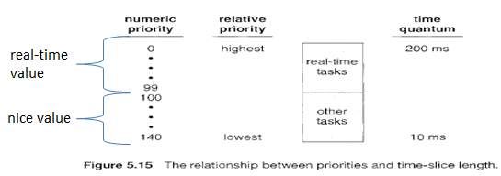
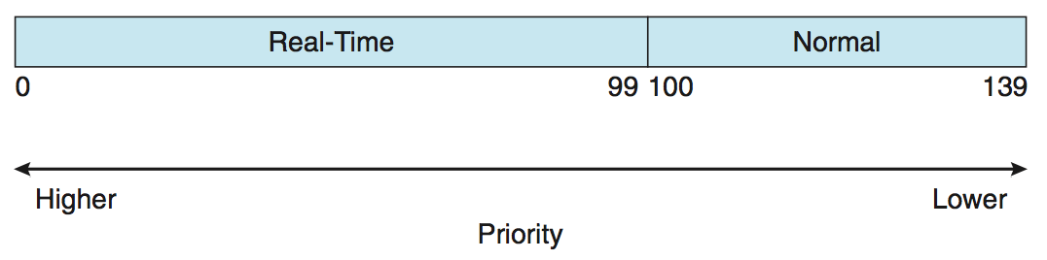
Linux Scheduling (Cont.)
Real-time scheduling according to POSIX.1b
Real-time tasks are assigned static priorities
Other tasks have
dynamic priorities that are based on their nice values plus or minus the value 5.
The interactivity of a task determines whether
the value 5 will be added to or subtracted from the nice value.
nice values

Slide 135
Linux Scheduling (Cont.)
A task's interactivity is determined by
how long it has been sleeping while waiting for I/0.

Slide 136
Linux Scheduling (Cont.)
Tasks that are more interactive typically have longer sleep times and therefore are more likely to have adjustments closer to -5,
As the scheduler favors interactive tasks, The result of such adjustments will be higher priorities for these tasks.

Slide 137
Linux Scheduling (Cont.)
Conversely, tasks with shorter sleep times are often more CPU-bound and thus will have their priorities lowered.

Slide 138
Linux Scheduling (Cont.)
Interactive Processes ?
These interact constantly with their users, and therefore spend a lot of time waiting for keypresses and mouse operations.
When input is received, the process must be woken up quickly, or the user will find the system to be unresponsive.
Typically, the average delay must fall between 50 and 150 ms.
The variance of such delay must also be bounded, or the user will find the system to be erratic.
Typical interactive programs are command shells, text editors, and graphical applications.

Slide 139
Linux Scheduling in Version 2.6.23 +
Completely Fair Scheduler (CFS)
It is default scheduling process since version 2.6.23.
Elegant handling of I/O and CPU bound process.
Each runnable process have a virtual time associated with it in PCB (process control block).

Slide 140
Linux Scheduling in Version 2.6.23 +
Whenever a context switch happens
then current running process virtual time is increased by
virtualruntime_currprocess+=T. where T is time for which it is executed recently.
Runtime for the process therefore monotonically increases.
So initially every process have some starting virtual time

Slide 141
Linux Scheduling in Version 2.6.23 +
CFS is quite simple algorithm for the process scheduling
It is implemented using RED BLACK Trees and not queues.
So all the process which are on main memory are inserted into Red Black trees and
whenever a new process comes it is inserted into the tree.
As we know that Red Black trees are self Balancing binary Search trees.

Slide 142
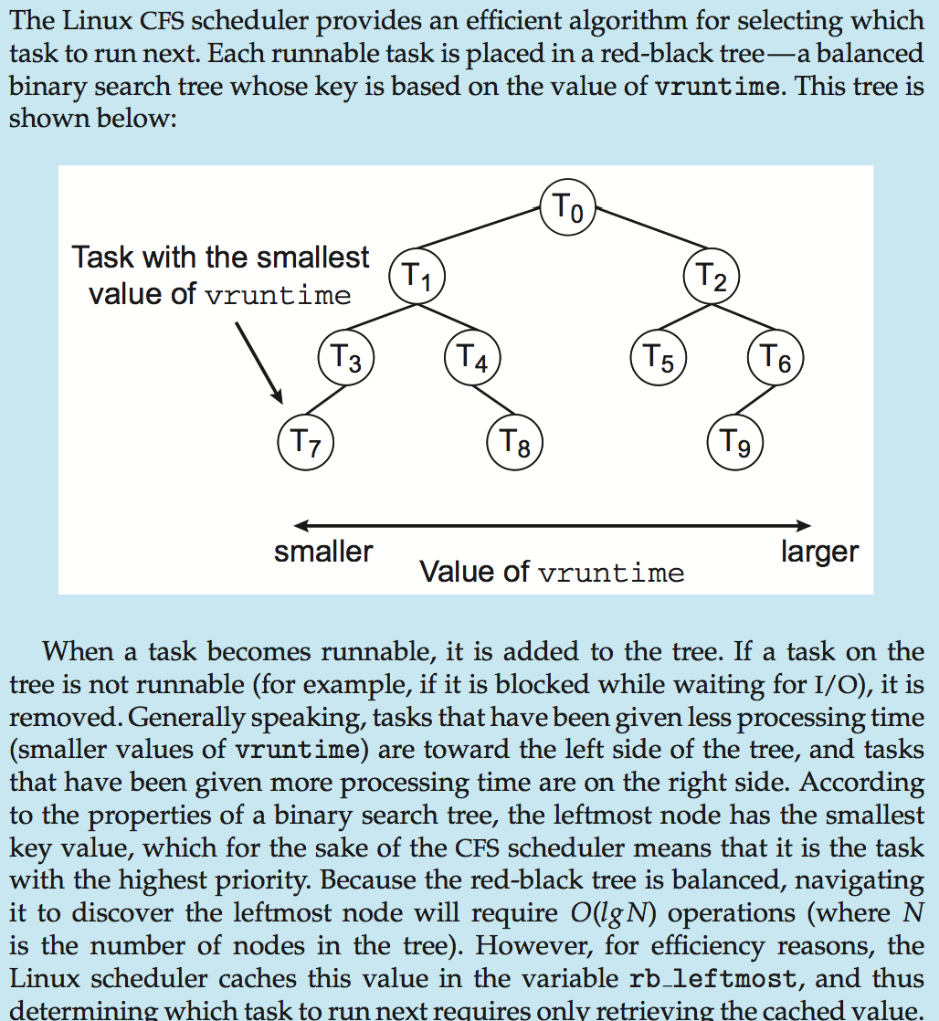
Linux Scheduling in Version 2.6.23 +
When context switch occurs –
The virtual time for the current process which was executing is updated .
The new process is decided
which has lowest virtual time and
that we know that is left most node of Red Black tree.

Slide 143
Linux Scheduling in Version 2.6.23 +
If the current process still has some burst time then it is inserted into the Red Black tree.
So this way each process gets fair time for the execution as
after every context switch the virtual time of a process increases and
thus priority shuffles.

Slide 144
CFS Performance

Slide 145
Thread Scheduling

Slide 146
Thread Scheduling
Distinction between user-level and kernel-level threads
On operating systems that support them,
it is kernel-level threads-not processes-that are being scheduled by the operating system.
User-level threads are managed by a thread library, and the kernel is unaware of them.

Slide 147
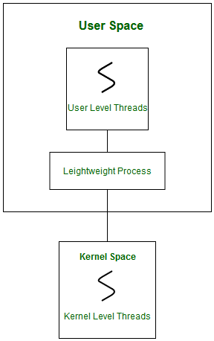
Thread Scheduling
To run on a CPU, user-level threads
must ultimately be mapped to an associated kernel-level thread,
Although this mapping may be indirect and may use a lightweight process (LWP).

Slide 148
Thread Scheduling
LWP-
Light-weight process are threads in the user space that acts as an interface for the ULT to access the physical CPU resources.

Slide 149
Thread Scheduling
LWP-
Thread library schedules which thread of a process to run on which LWP and how long.
The number of LWP created by the thread library depends on the type of application

Slide 150
Thread Scheduling
When we say the thread library schedules user threads onto available LWPs,
we do not mean that the thread is actually running on a CPU;
this would require the operating system to schedule the kernel thread onto a physical CPU.

Slide 151
Process Contention Scope (PCS)
Many-to-one and many-to-many models,
thread library schedules user-level threads to run on LWP
Known as process-contention scope (PCS) since scheduling competition is within the process
Typically done via priority set by programmer
The contention takes place among threads within a same process.

Slide 152
System Contention Scope (SCS)
Kernel thread scheduled onto available CPU is system-contention scope (SCS)
i.e. Decide which Kernel thread to execute on the CPU
Competition for the CPU with SCS scheduling takes place among all kernel threads in system
The contention takes place among all kernel threads in the system

Slide 153
PCS Scheduling
PCS is done according to priority-
the scheduler selects the runnable thread with the highest priority to run.
User-level thread priorities
are set by the programmer and
are not adjusted by the thread library,
Although some thread libraries may allow the programmer to change the priority of a thread.

Slide 154
PCS Scheduling
PCS will typically
preempt the thread currently running in favor of a higher-priority thread;
However, there is no guarantee of time slicing among threads of equal priority.

Slide 155
Pthread
POSIX Threads,
Referred to as pthreads,
An execution model that exists independently from a language,
As a parallel execution model.
POSIX Threads is an API defined by the standard POSIX.1c

Slide 156
Pthread
It allows a program to control multiple different flows of work that overlap in time.
Each flow of work is referred to as a thread.
Creation and control over these flows is achieved by making calls to the POSIX Threads API.

Slide 157
Pthread Scheduling
API allows specifying –
Either PCS or SCS during thread creation
PTHREAD_SCOPE_PROCESS schedules threads using PCS scheduling
PTHREAD_SCOPE_SYSTEM schedules threads using SCS scheduling

Slide 158
Pthread Scheduling
Systems using the one-to-one model
such as Windows XP, Solaris, and Linux,
schedule threads using only SCS.
Can be limited by OS – Linux and Mac OS X only allow PTHREAD_SCOPE_SYSTEM

Slide 159
Pthread Scheduling
The Pthread IPC provides two functions for getting-and setting-the contention scope policy:
pthread_attr_setscope(pthread_attr_t *attr, int scope)
pthread_attr_getscope(pthread_attr_t *attr, int *scope)

Slide 160
Pthread Scheduling
pthread_attr_setscope(pthread_attr_t *attr, int scope)
Description:
Sets the thread contention scope attribute in the thread attribute object attr to the value specified in scope.
Sets the scope attribute in the attr object.
http://www.qnx.com/developers/docs/qnxcar2/index.jsp?topic=%2Fcom.qnx.doc.neutrino.lib_ref%2Ftopic%2Fp%2Fpthread_attr_setscope.html

Slide 161
Pthread Scheduling
pthread_attr_setscope(pthread_attr_t *attr, int scope)
1st parameter for both functions
attr -Specifies the thread attributes object.
A pointer to the pthread_attr_t structure that defines the attributes to use when creating new threads
http://www.qnx.com/developers/docs/qnxcar2/index.jsp?topic=%2Fcom.qnx.doc.neutrino.lib_ref%2Ftopic%2Fp%2Fpthread_attr_setscope.html

Slide 162
Pthread Scheduling
pthread_attr_setscope(pthread_attr_t *attr, int scope)
2nd parameter :
The new value for the contention scope attribute
The second parameter defines the scope of contention for the thread pointed.
It takes two values.
PTHREAD_SCOPE_SYSTEM
PTHREAD_SCOPE_PROCESS
indicating how the contention scope is to be set.
http://www.qnx.com/developers/docs/qnxcar2/index.jsp?topic=%2Fcom.qnx.doc.neutrino.lib_ref%2Ftopic%2Fp%2Fpthread_attr_setscope.html

Slide 163
Pthread Scheduling
pthread_attr_setscope(pthread_attr_t *attr, int scope)
Return Values-
Upon successful completion, the pthread_attr_getscope and pthread_attr_setscope subroutines return a value of 0.
Otherwise, an error number is returned to indicate the error.
https://www.ibm.com/docs/en/aix/7.2?topic=p-pthread-attr-getscope-pthread-attr-setscope-subroutines

Slide 164
Pthread Scheduling
pthread_attr_getscope(pthread_attr_t *attr, int *scope)
Description:
Gets the thread contention scope attribute from the thread attribute object attr and returns it in scope.
http://www.qnx.com/developers/docs/qnxcar2/index.jsp?topic=%2Fcom.qnx.doc.neutrino.lib_ref%2Ftopic%2Fp%2Fpthread_attr_setscope.html

Slide 165
Pthread Scheduling
pthread_attr_getscope(pthread_attr_t *attr, int *scope)
1st parameter for both functions
attr -Specifies the thread attributes object.
A pointer to the pthread_attr_t structure that defines the attributes to use when creating new threads
2nd parameter :
A pointer to a location where the function can store the current contention scope.
http://www.qnx.com/developers/docs/qnxcar2/index.jsp?topic=%2Fcom.qnx.doc.neutrino.lib_ref%2Ftopic%2Fp%2Fpthread_attr_setscope.html

Slide 166
pthread_attr_t *attr
The thread attributes structure
When you start a new thread, it can assume some well-defined defaults, or you can explicitly specify its characteristics.
http://www.qnx.com/developers/docs/qnxcar2/index.jsp?topic=%2Fcom.qnx.doc.neutrino.getting_started%2Ftopic%2Fs1_procs_thread_attr.html

Slide 167
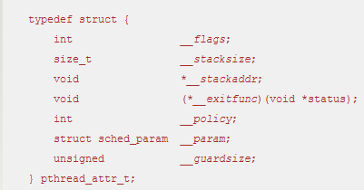
pthread_attr_t *attr
Let's look at the pthread_attr_t data type:

Slide 168
pthread_attr_t *attr
Basically, the fields are used as follows:
__flags -Non-numerical (Boolean) characteristics
__stacksize, __stackaddr, and __guardsize-Stack specifications.
__exitfunc- Function to execute at thread exit.
__policy and __param- Scheduling parameters.

Slide 169
Pthread Example
The program first determines the existing contention scope and sets it to PTHREAD_SCOPE_SYSTEM.
It then creates five separate threads that will run using the SCS scheduling policy.

Slide 170
Pthread Scheduling
pthread_attr_init()
Initialize a thread-attribute object
Synopsis:
#include <pthread.h>
int pthread_attr_init( pthread_attr_t *attr );
Arguments:
attr -A pointer to the pthread_attr_t structure that you want to initialize.
http://www.qnx.com/developers/docs/qnxcar2/index.jsp?topic=%2Fcom.qnx.doc.neutrino.lib_ref%2Ftopic%2Fp%2Fpthread_attr_setscope.html

Slide 171
Pthread Example
#include <pthread.h>
#include <stdio.h>
#define NUM_THREADS 5
int main(int argc, char *argv[]) {
int i, scope; pthread_t tid[NUM THREADS];
pthread_attr_t attr;
/* get the default attributes */
pthread_attr_init(&attr);
/* first inquire on the current scope */ if (pthread_attr_getscope(&attr, &scope) != 0)
fprintf(stderr, "Unable to get scheduling scope\n");
else {
if (scope == PTHREAD_SCOPE_PROCESS)
printf("PTHREAD_SCOPE_PROCESS");
else if (scope == PTHREAD_SCOPE_SYSTEM)
printf("PTHREAD_SCOPE_SYSTEM");
else fprintf(stderr, "Illegal scope value.\n");
}

Slide 172
Pthread Scheduling API
/* set the scheduling algorithm to PCS or SCS */
pthread_attr_setscope(&attr, PTHREAD_SCOPE_SYSTEM);
/* create the threads */ for (i = 0; i < NUM_THREADS; i++)
pthread_create(&tid[i],&attr,runner,NULL);
/* now join on each thread */ for (i = 0; i < NUM_THREADS; i++)
pthread_join(tid[i], NULL);
}
/* Each thread will begin control in this function */
void *runner(void *param) {
/* do some work ... */
pthread_exit(0);
}

Slide 173
Pthread Scheduling
pthread_create()
Create a thread
Synopsis:
#include <pthread.h>
int pthread_create( pthread_t* thread, const pthread_attr_t* attr, void* (*start_routine)(void* ), void* arg );
http://www.qnx.com/developers/docs/qnxcar2/index.jsp?topic=%2Fcom.qnx.doc.neutrino.lib_ref%2Ftopic%2Fp%2Fpthread_attr_setscope.html

Slide 174
Pthread Scheduling
int pthread_create( pthread_t* thread, const pthread_attr_t* attr, void* (*start_routine)(void* ), void* arg );
Arguments:
thread –
a pointer to a pthread_t object where the function can store the thread ID of the new thread.

Slide 175
pthread_t
pthread_t is the data type used to uniquely identify a thread.
Used by the application in function calls that require a thread identifier.

Slide 176
Pthread Scheduling
int pthread_create( pthread_t* thread, const pthread_attr_t* attr, void* (*start_routine)(void* ), void* arg );
Arguments:
attr -
A pointer to a pthread_attr_t structure that specifies the attributes of the new thread.
Instead of manipulating the members of this structure directly, use pthread_attr_init() and the pthread_attr_set_* functions.
If you modify the attributes in attr after creating the thread, the thread's attributes aren't affected.

Slide 177
Pthread Scheduling
int pthread_create( pthread_t* thread, const pthread_attr_t* attr, void* (*start_routine)(void* ), void* arg );
Arguments:
start_routine-
The routine where the thread begins, with arg as its only argument.
http://www.qnx.com/developers/docs/qnxcar2/index.jsp?topic=%2Fcom.qnx.doc.neutrino.lib_ref%2Ftopic%2Fp%2Fpthread_attr_setscope.html

Slide 178
Pthread Scheduling
int pthread_create( pthread_t* thread, const pthread_attr_t* attr, void* (*start_routine)(void* ), void* arg );
Arguments:
arg The argument to pass to start_routine.
http://www.qnx.com/developers/docs/qnxcar2/index.jsp?topic=%2Fcom.qnx.doc.neutrino.lib_ref%2Ftopic%2Fp%2Fpthread_attr_setscope.html

Slide 179
pthread_create()
int pthread_create(pthread_t *thread, const pthread_attr_t *attr, void *(*start_routine) (void *), void *arg);
RETURN VALUE
On success, pthread_create() returns 0;
On error, it returns an error number, and the contents of *thread are undefined.

Slide 180
Pthread Scheduling
int pthread_create( pthread_t* thread, const pthread_attr_t* attr, void* (*start_routine)(void* ), void* arg );
pthread_create(&tid[i],&attr,runner,NULL);
http://www.qnx.com/developers/docs/qnxcar2/index.jsp?topic=%2Fcom.qnx.doc.neutrino.lib_ref%2Ftopic%2Fp%2Fpthread_attr_setscope.html

Slide 181
Pthread Scheduling API
/* set the scheduling algorithm to PCS or SCS */
pthread_attr_setscope(&attr, PTHREAD_SCOPE_SYSTEM);
/* create the threads */ for (i = 0; i < NUM_THREADS; i++)
pthread_create(&tid[i],&attr,runner,NULL);
/* now join on each thread */ for (i = 0; i < NUM_THREADS; i++)
pthread_join(tid[i], NULL);
}
/* Each thread will begin control in this function */
void *runner(void *param) {
/* do some work ... */
pthread_exit(0);
}

Slide 182
Pthread Scheduling
Joining
The simplest method of synchronization is to join the threads as they terminate.
Joining really means waiting for termination.
Joining is accomplished by one thread waiting for the termination of another thread. The waiting thread calls pthread_join()

Slide 183
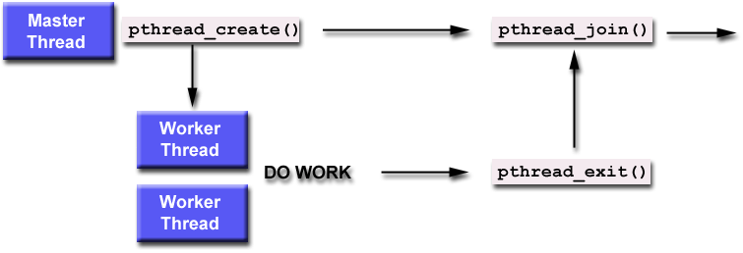
Pthread Scheduling
Joining

Slide 184
Pthread Scheduling
int pthread_join( pthread_t thread, void** value_ptr );
Eg-pthread_join(tid[i], NULL);
Arguments:
thread –
The target thread whose termination you're waiting for,
Pass it the thread ID of the thread that you wish to join
value_ptr –
An optional value_ptr, which can be used to store the termination return value from the joined thread.
NULL, or a pointer to a location where the function can store the value passed to pthread_exit() by the target thread.
You can pass in a NULL if you aren't interested in this value

Slide 185
Pthread Scheduling
The pthread_join function returns an integer value that also indicates different error codes.
Return Value-
0 if the call was successful and this guarantees the given thread has terminated.
EDEADLK- a deadlock was detected.
EINVAL- the given thread is not joinable
ESRCH- the given thread ID can’t be found.

Slide 186
Pthread Scheduling API
/* set the scheduling algorithm to PCS or SCS */
pthread_attr_setscope(&attr, PTHREAD_SCOPE_SYSTEM);
/* create the threads */ for (i = 0; i < NUM_THREADS; i++)
pthread_create(&tid[i],&attr,runner,NULL);
/* now join on each thread */ for (i = 0; i < NUM_THREADS; i++)
pthread_join(tid[i], NULL);
}
/* Each thread will begin control in this function */
void *runner(void *param) {
/* do some work ... */
pthread_exit(0);
}
The calling thread waits for every thread with the pthread_join call in the loop

Slide 187
Pthread Scheduling API
#include <pthread.h>
#include <stdio.h>
#define NUM_THREADS 5
int main(int argc, char *argv[]) {
int i, scope; pthread_t tid[NUM THREADS];
pthread_attr_t attr;
/* get the default attributes */
pthread_attr_init(&attr);
/* first inquire on the current scope */ if (pthread_attr_getscope(&attr, &scope) != 0)
fprintf(stderr, "Unable to get scheduling scope\n");
else {
if (scope == PTHREAD_SCOPE_PROCESS)
printf("PTHREAD_SCOPE_PROCESS");
else if (scope == PTHREAD_SCOPE_SYSTEM)
printf("PTHREAD_SCOPE_SYSTEM");
else fprintf(stderr, "Illegal scope value.\n");
}
/* set the scheduling algorithm to PCS or SCS */
pthread_attr_setscope(&attr, PTHREAD_SCOPE_SYSTEM);
/* create the threads */ for (i = 0; i < NUM_THREADS; i++)
pthread_create(&tid[i],&attr,runner,NULL);
/* now join on each thread */ for (i = 0; i < NUM_THREADS; i++)
pthread_join(tid[i], NULL);
}
/* Each thread will begin control in this function */
void *runner(void *param) {
/* do some work ... */
pthread_exit(0);
}

Slide 188
Pthread Scheduling
pthread_exit()
Terminate a thread
Synopsis:
#include <pthread.h>
void pthread_exit( void* value_ptr );

Slide 189
Pthread Scheduling
void pthread_exit( void* value_ptr );
Arguments:
value_ptr -A pointer to a value that you want to be made available to any thread joining the thread that you're terminating.
Description:
Terminates the calling thread.
This routine kills the thread
If the thread is joinable, the value value_ptr is made available to any thread joining the terminating thread (only one thread can get the return status).
If the thread is detached, all system resources allocated to the thread are immediately reclaimed.

Slide 190
Diff between exit and joining?
pthread_exit is called from the thread itself to terminate its execution (and return a result) early.
pthread_join is called from another thread (usually the thread that created it) to wait for a thread to terminate and obtain its return value.
It can be called before or after the thread you're waiting for calls pthread_exit.
If before, it will wait for the exit to occur.
If after, it simply obtains the return value and releases the pthread_t resources.
https://codehunter.cc/a/c/difference-between-pthread-exit-pthread-join-and-pthread-detach

Slide 191
#include <stdio.h>
#include <stdlib.h>
#include <unistd.h> //Header file for sleep()
#include <pthread.h>
// A normal C function that is executed as a thread
// when its name is specified in pthread_create()
void *myThreadFun(void *vargp)
{
sleep(1);
printf("Printing Hello from Thread \n");
return NULL;
}
int main()
{
pthread_t thread_id;
printf("Before Thread\n");
pthread_create(&thread_id, NULL, myThreadFun, NULL);
pthread_join(thread_id, NULL);
printf("After Thread\n");
exit(0);
}
Output ?

Slide 192
#include <stdio.h>
#include <stdlib.h>
#include <unistd.h> //Header file for sleep()
#include <pthread.h>
// A normal C function that is executed as a thread
// when its name is specified in pthread_create()
void *myThreadFun(void *vargp)
{
sleep(1);
printf("Printing Hello from Thread \n");
return NULL;
}
int main()
{
pthread_t thread_id;
printf("Before Thread\n");
pthread_create(&thread_id, NULL, myThreadFun, NULL);
pthread_join(thread_id, NULL);
printf("After Thread\n");
exit(0);
}
Output-
Before Thread
Printing Hello from Thread
After Thread

Slide 193
#include <iostream>
#include <stdlib>
#include <pthread.h>
using namespace std;
#define NUM_THREADS 5
void *PrintHello(void *threadid) {
long tid;
tid = (long)threadid;
printf("Hello World! Thread ID, %d\n", tid);
pthread_exit(NULL);
}
int main () {
pthread_t threads[NUM_THREADS];
int rc;
int i;
for( i = 0; i < NUM_THREADS; i++ ) {
cout << "main() : creating thread, " << i << endl;
rc = pthread_create(&threads[i], NULL, PrintHello, (void *)i);
if (rc) {
printf("Error:unable to create thread, %d\n", rc);
exit(-1);
}
}
pthread_exit(NULL);
}
Output ?

Slide 194
#include <iostream>
#include <stdlib>
#include <pthread.h>
using namespace std;
#define NUM_THREADS 5
void *PrintHello(void *threadid) {
long tid;
tid = (long)threadid;
printf("Hello World! Thread ID, %d\n", tid);
pthread_exit(NULL);
}
int main () {
pthread_t threads[NUM_THREADS];
int rc;
int i;
for( i = 0; i < NUM_THREADS; i++ ) {
cout << "main() : creating thread, " << i << endl;
rc = pthread_create(&threads[i], NULL, PrintHello, (void *)i);
if (rc) {
printf("Error:unable to create thread, %d\n", rc);
exit(-1);
}
}
pthread_exit(NULL);
}
IDEAL?
Output-
main() : creating thread, 0
main() : creating thread, 1
main() : creating thread, 2
main() : creating thread, 3
main() : creating thread, 4
Hello World! Thread ID, 0
Hello World! Thread ID, 1
Hello World! Thread ID, 2
Hello World! Thread ID, 3
Hello World! Thread ID, 4

Slide 195
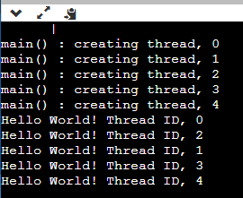
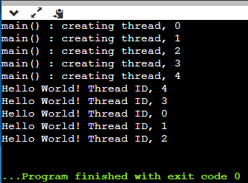
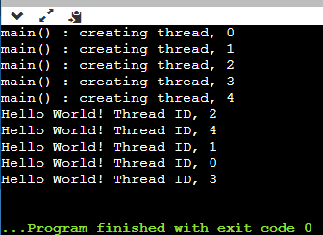
Sequence/No Sequence?

Slide 196
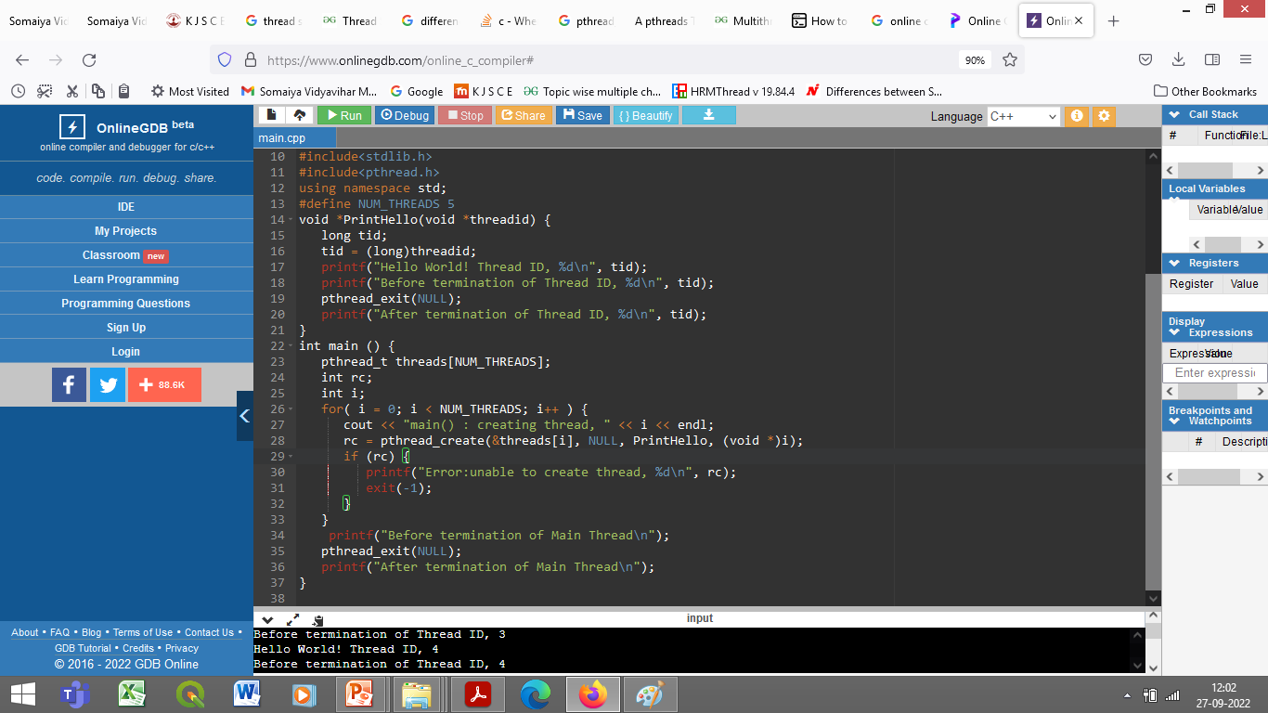
Playing around with the Code

Slide 197
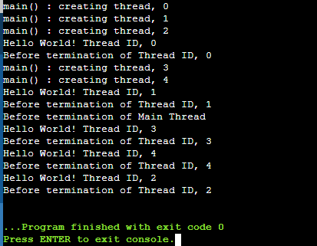
Playing around with the Code

